Slide 1
Dynamic Bond

Slide 2
Background
epoxy resin (ingerent defect)
Brittleness
less resistant to crack initation and growth

Slide 3
Background
Epoxy Resin System introduce

Slide 4
Previous Research
Ambition: increasing toughness and energy dissipation capacity without sacrific strength

Slide 5
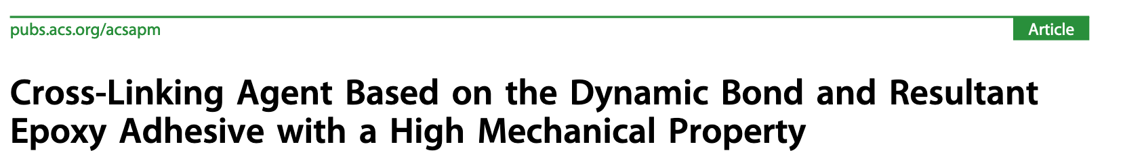
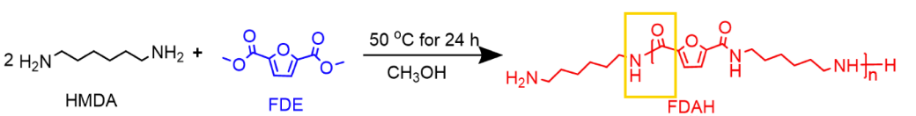
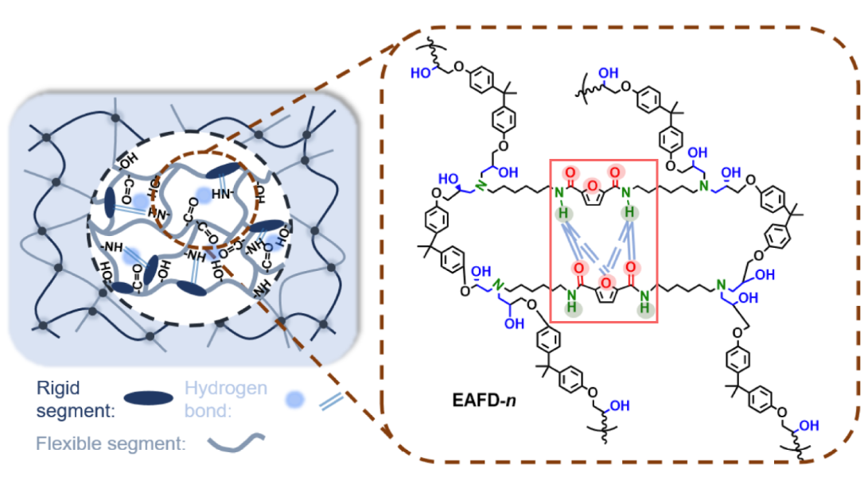

Slide 6
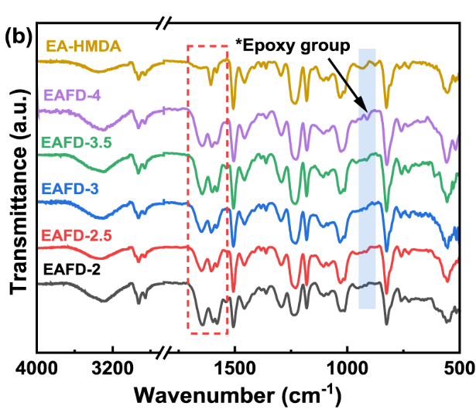
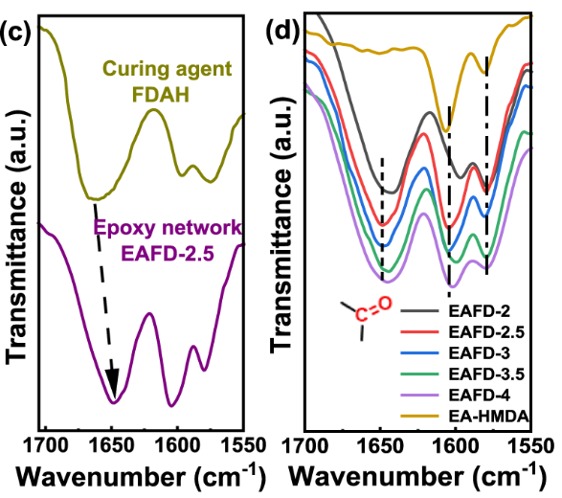
Result & Discussion
Charactristic the system introduce the Hydrongen bond invalidly.

Slide 7
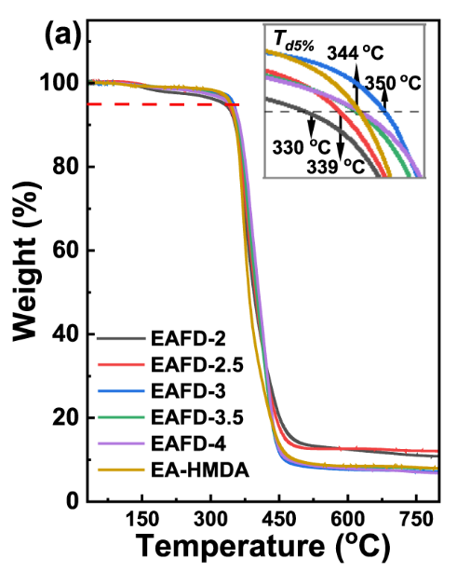
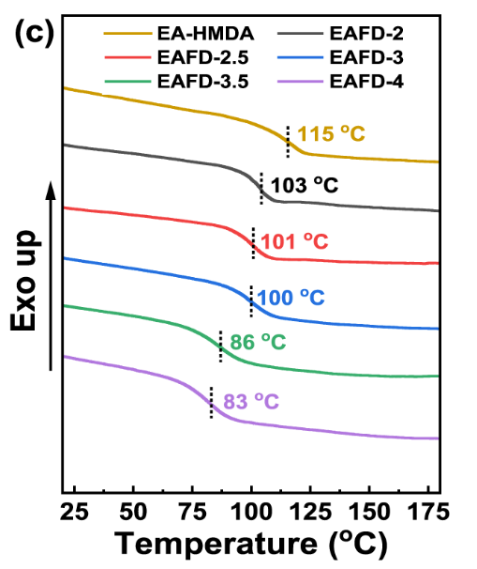
thermal stabiity;
glass transition temperature

Slide 8
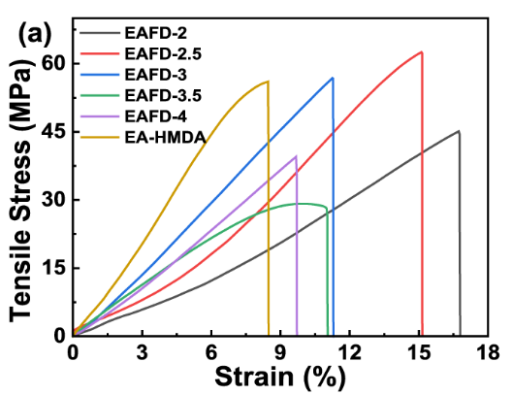
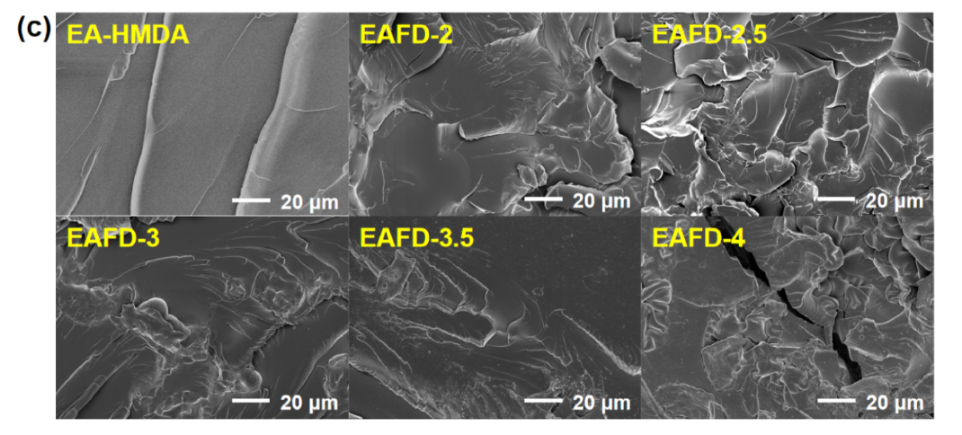

Slide 9
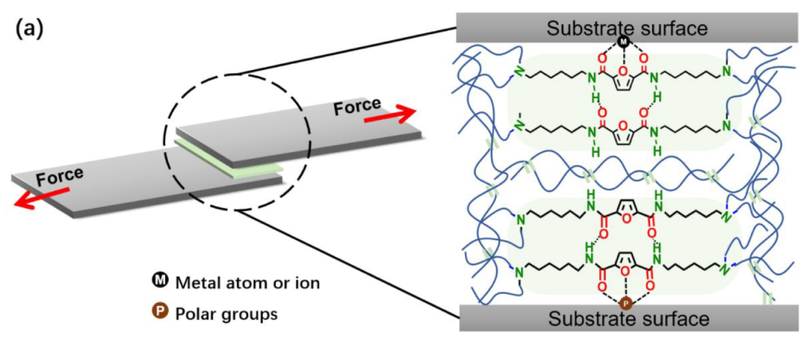

Slide 10
Summary
合成了含呋喃环的固化剂用于环氧体系，使环氧体系中引入了氢键，与常规固化剂得出的环氧体系相比，韧性得到提升的同时，其他性能也保持稳定

